Slide 1



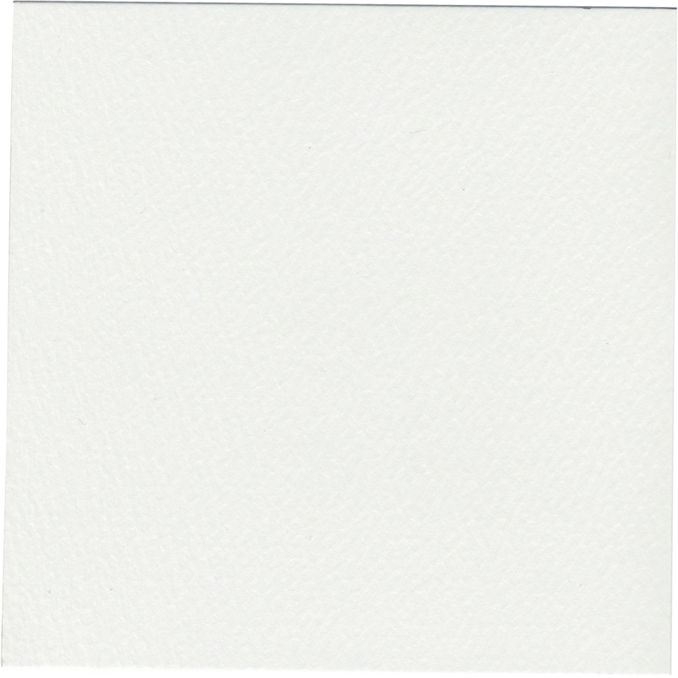
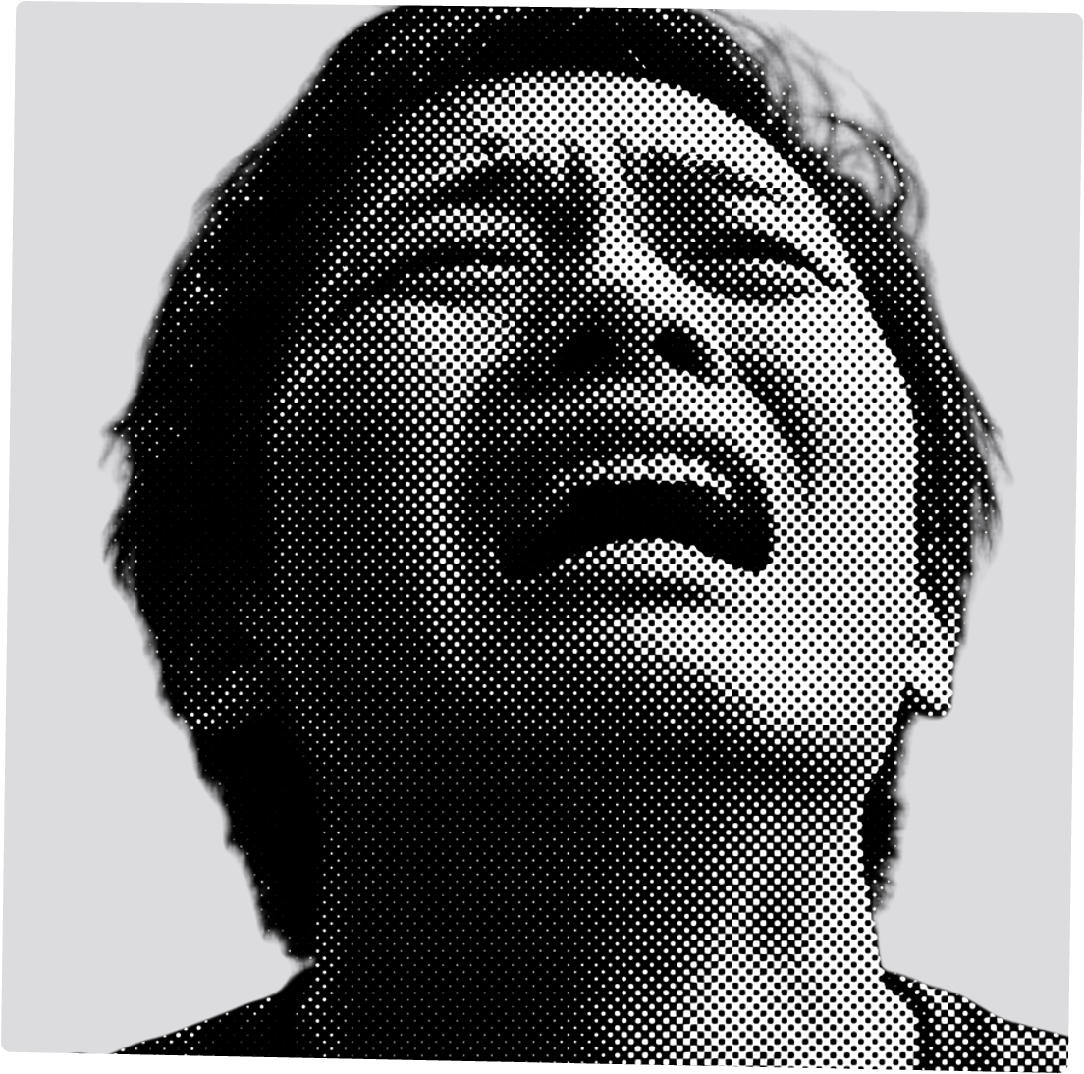


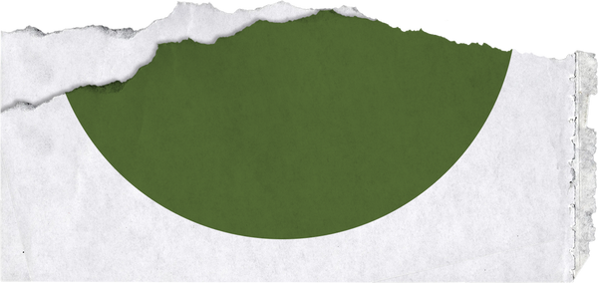
my
year
in
breakdowns
2
0
3
0

Slide 2

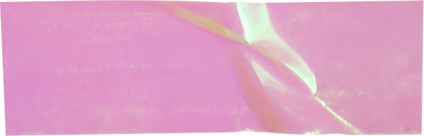


(My boss)
The Biggest Stressor Award goes to:
Dominico Pascal
For always messaging me outside of work hours and following up on every single task.

Slide 3
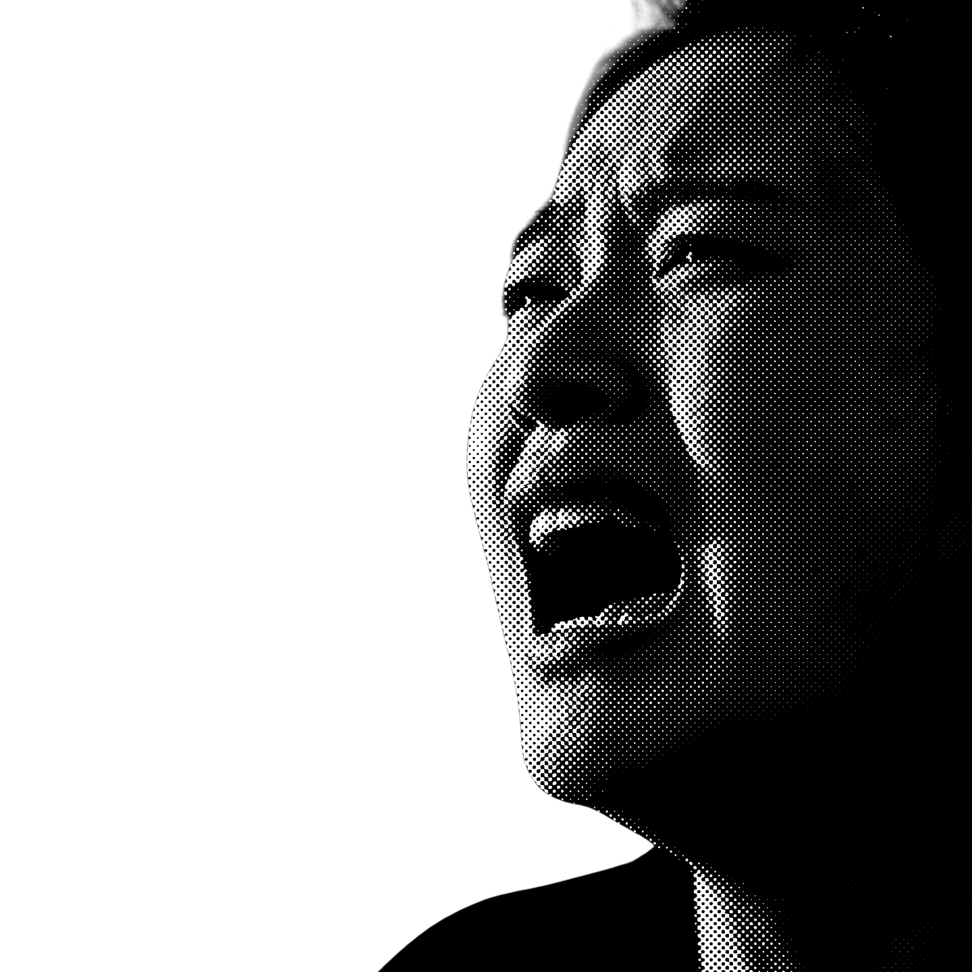

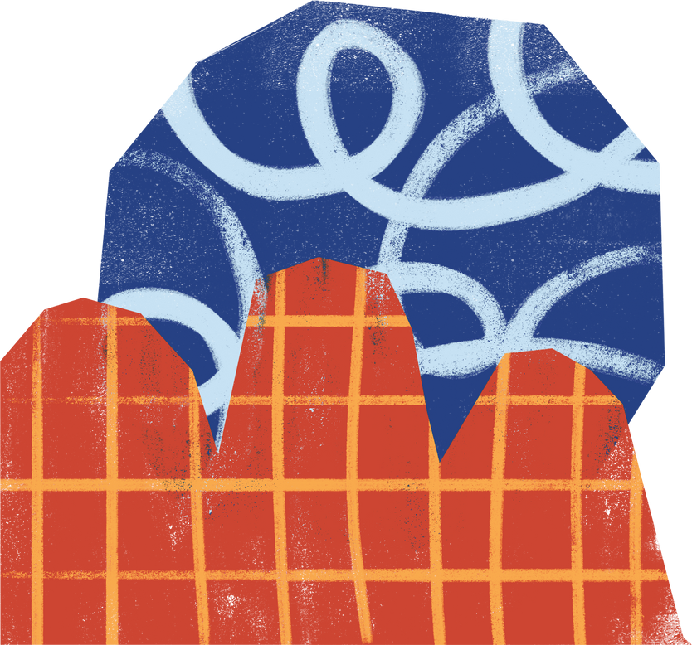
Worst crash out
Date: March 30, 2030
Duration: 30 minutes
Location: 123 Anywhere St., Any City, ST 12345
(my home office)
Reason: I checked my savings account after paying for the previous month’s credit card bill.

Slide 4
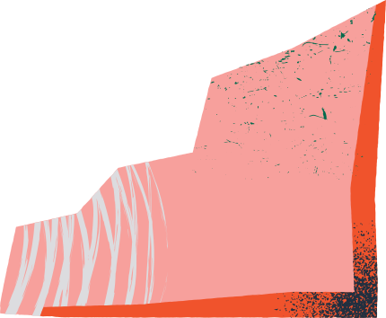
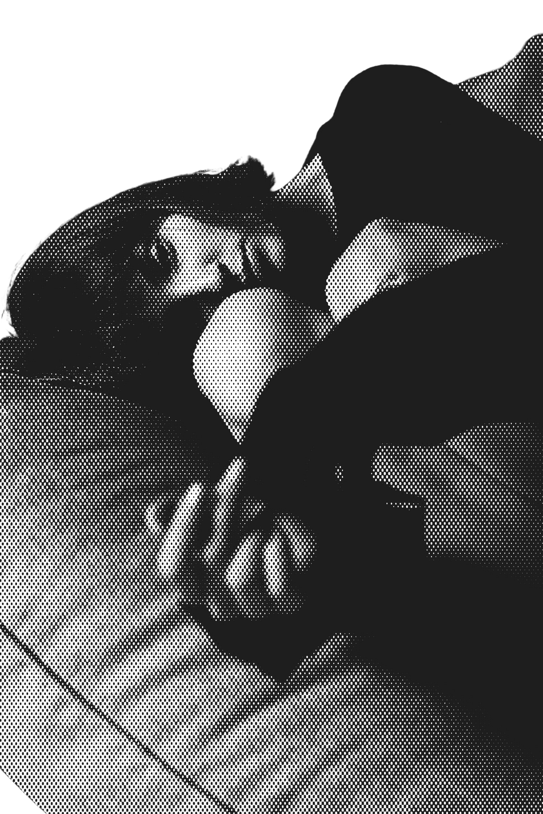
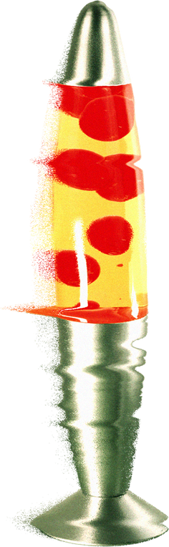

My Most Used Breakdown Pose was:
Fetal Position
(In bed)
Because nothing’s cozier than crashing
out all curled up under my sheets.

Slide 5



My Top 3 Post-Breakdown
Guilty Pleasures were:
Ice Cream
Streaming
Oversleeping
Flavor of choice: Cookies and Cream
Plus a side of tortilla chips and a good dip
Because you can’t crash out if you’re not awake

Slide 6

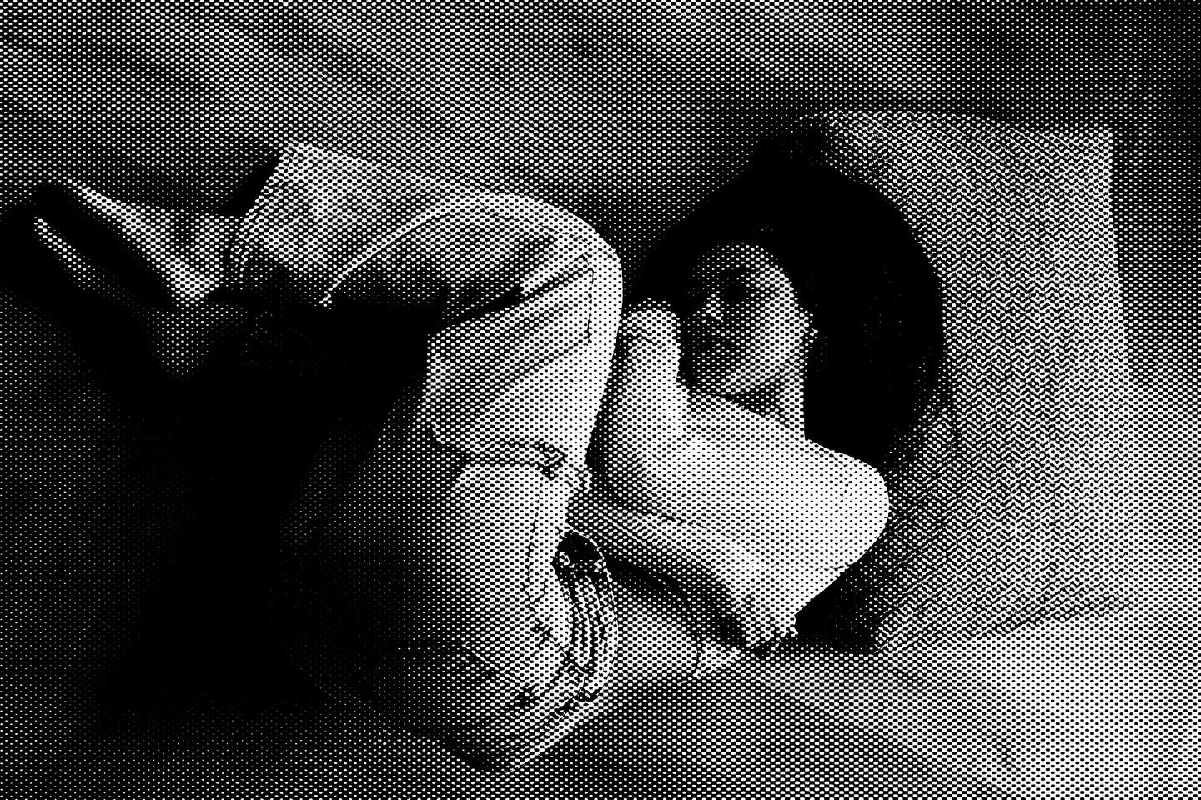
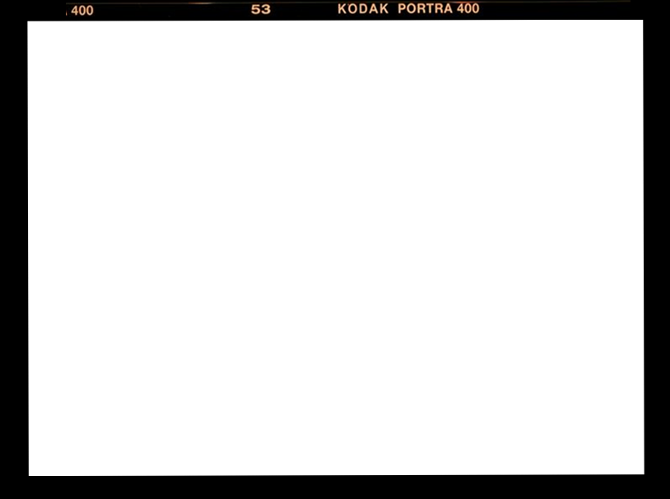


My health in numbers
$1,300
4
Total medical bills
Number of times I caught the flu
2
11
Trips to the emergency room
Number of sick days used

Slide 7






“Most folks are as happy as they make up their minds to be.”
— Abraham Lincoln

Slide 8
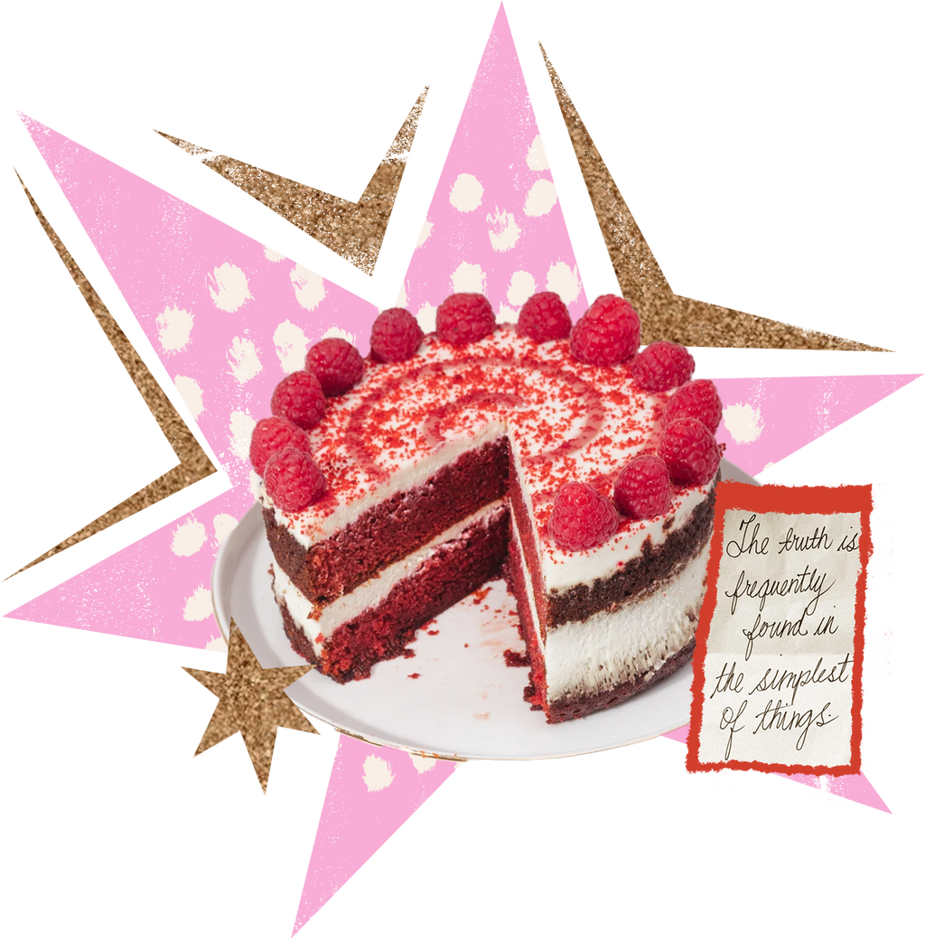
Thank
you
for
viewing
(and sharing in my misery)!

Slide 9
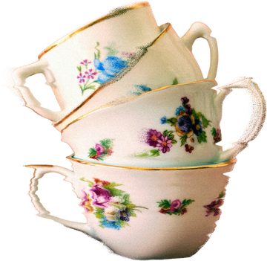
Resource Page
Use these in your presentation. Delete or hide this page before presenting.
Fonts
Design Elements / Icons
This presentation template
uses the following free fonts:
TITLES:
Just Another Hand
BODY TEXT:
Special Elite
You can find these fonts online too.
Colors
#ED7843
#ED7843
#ED7843
#ED7843
#ED7843

Slide 10

Credits
This presentation template is free for everyone to use, thanks to the following:
for this presentation template
Pexels, Pixabay, Sketchify
for the photos, graphics, and elements
Happy designing!

